Slide 1

AdventureCo – Discover the World
A B.Tech Mini Project: Modern Travel & Tourism Website

Slide 2

Website Purpose & Target Users
Purpose
Target Users
To design and develop a modern travel website using HTML5 and CSS3, showcasing destinations, tours, reviews, and company information with a professional UI layout.
Students
Travel Enthusiasts
Beginners in Web Development
Educational Institutions

Slide 3



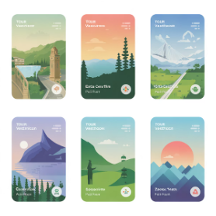


Key Features of AdventureCo
Multi-page Layout
Responsive Grid System
Hero Search UI
Destination & Tour Cards
Prominent and intuitive search functionality.
Structured for comprehensive content display.
Ensures optimal viewing on any device.
Visually appealing display of travel options.
Reviews & Testimonials
Contact Form & Newsletter
Showcases customer feedback and experiences.
Easy communication and updates for users.

Slide 4





Development Tools
HTML5
CSS3
Visual Studio Code
For structuring web content.
For styling and visual design.
Primary code editor.
Google Fonts
Chrome Browser
For diverse typography.
For testing and development.

Slide 5
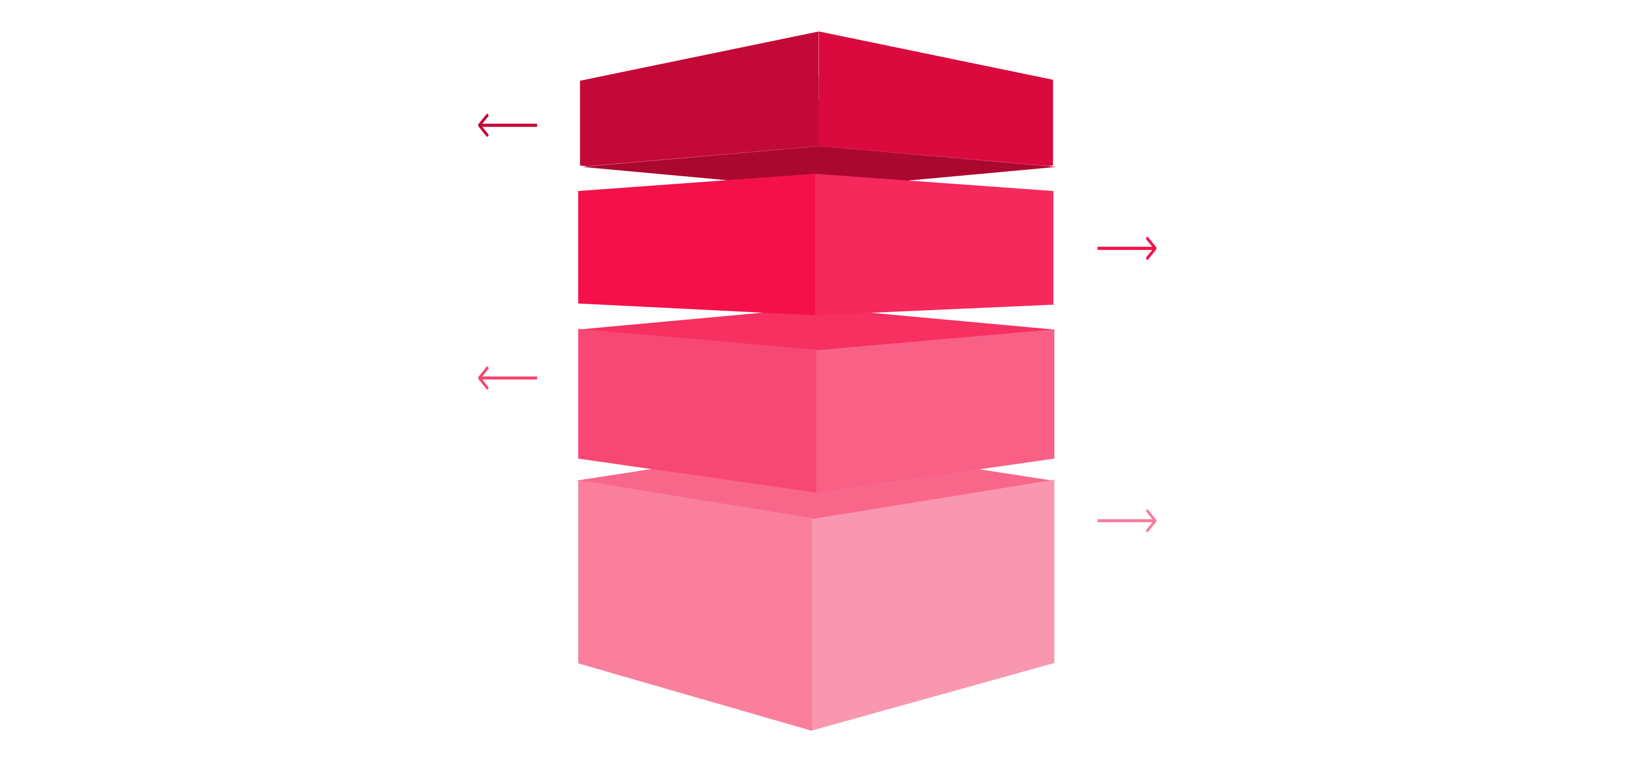
Website File Structure
Root Index
Main entry point: index.html
Primary Pages
destination.html, tours.html & about.html
Support Pages
reviews.html & contact.html
Stylesheet
style.css for site-wide styling
The project is organized into distinct HTML files for each page and a central CSS file for styling, ensuring modularity and ease of maintenance.

Slide 6
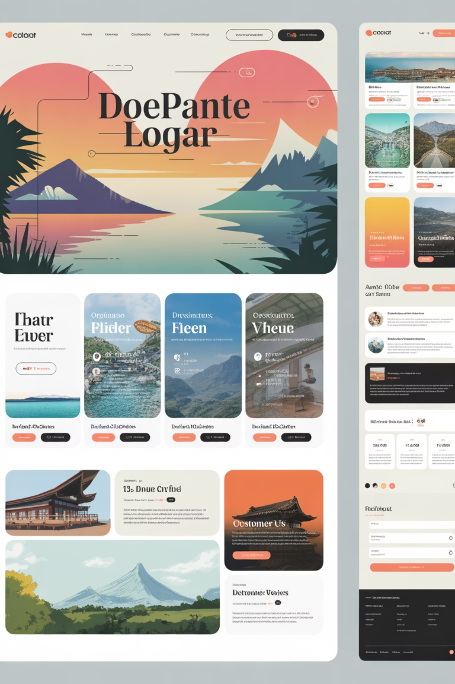
Core Page Descriptions
Home Page
About
Hero section, destinations, tours, testimonials, newsletter.
Company story, mission, and statistics.
Destinations
Reviews
International travel locations with pricing cards.
Customer testimonials with star ratings.
Tours
Contact
Curated travel packages with duration, ratings, and booking buttons.
Address, email, phone, and inquiry form.

Slide 7

Live Website Preview
Explore the functional AdventureCo website, featuring an engaging hero section with prominent search functionality, key travel statistics showcasing 150+ destinations, 50K+ happy travelers, and 12K+ tour packages, all integrated within an intuitive navigation system for a seamless user experience.

Slide 8
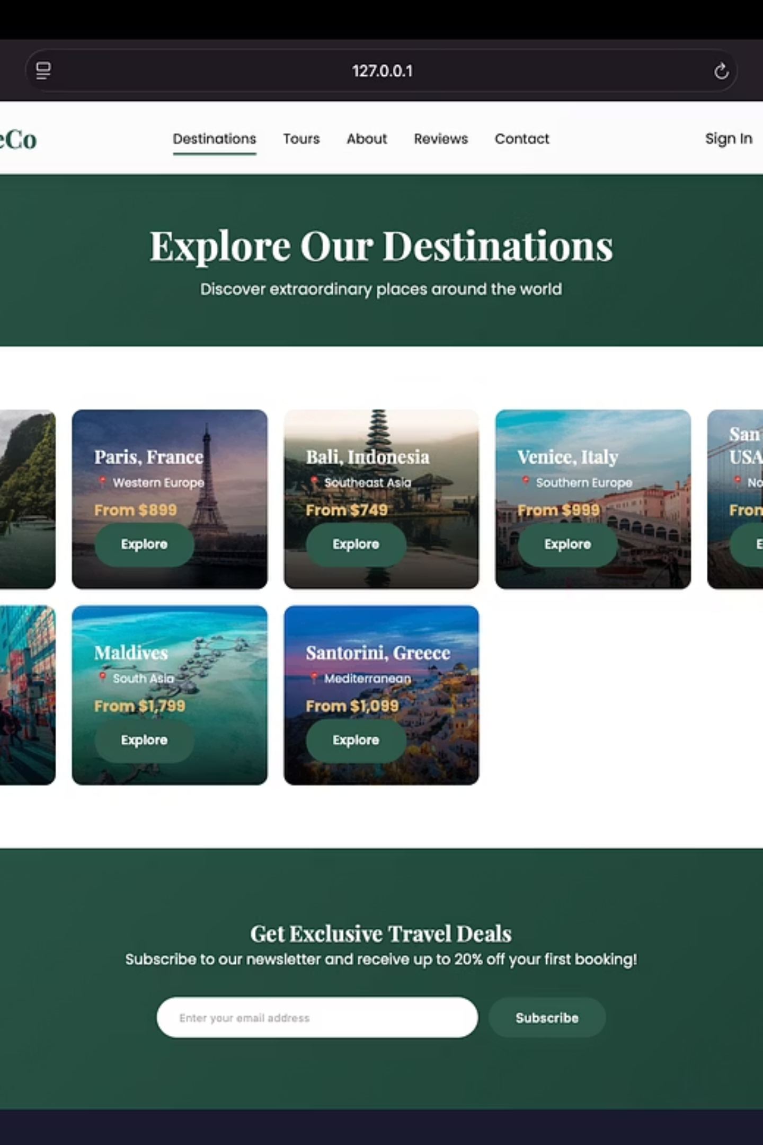
Destinations Page
Showcasing the Destinations page with destination cards featuring international travel locations, pricing information, and an exclusive travel deals newsletter signup.

Slide 9

Tour Collections Page
The Tour Collections page displaying curated travel packages with detailed tour cards, pricing, star ratings, and "Book Now" buttons for easy booking.

Slide 10
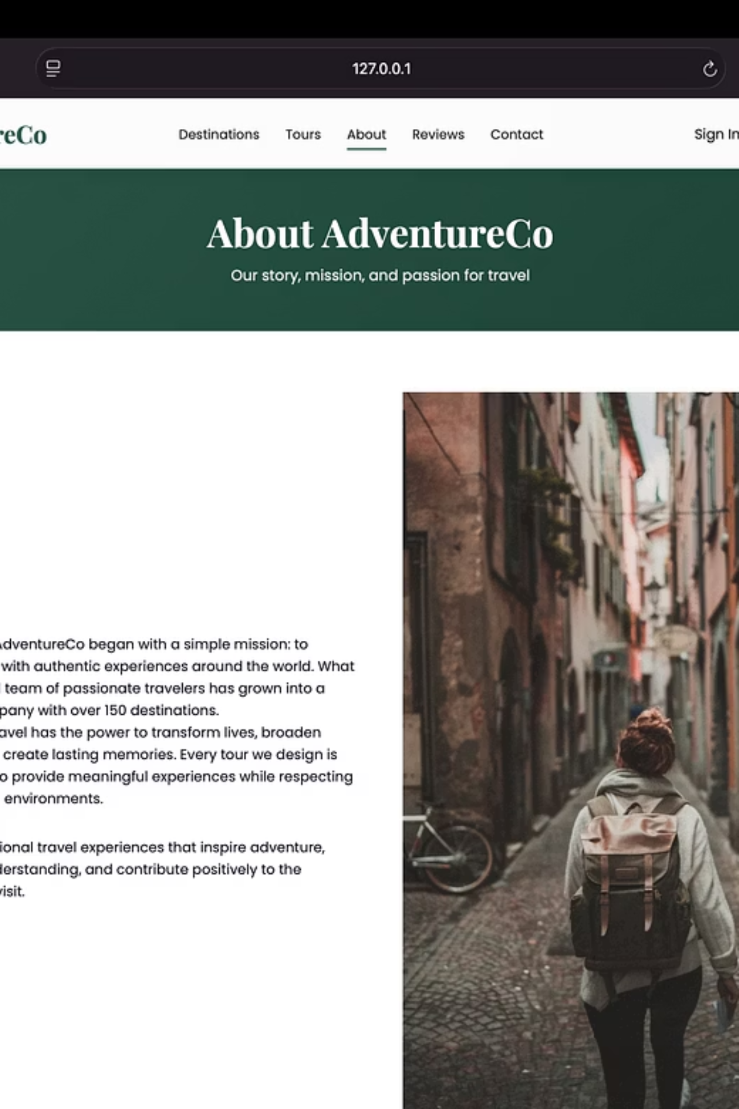
About AdventureCo Page
The About page featuring the company story and mission statement alongside compelling imagery that reflects the brand's travel and adventure values.

Slide 11


Why Travel With AdventureCo
Highlighting the key benefits and reasons to choose AdventureCo, featuring trust badges, expert guides, easy booking, and best price guarantees with impressive statistics.
Trust Badges & Security
Expert Guides
Ensuring your peace of mind with verified credentials and secure transactions.
Led by seasoned professionals dedicated to making your adventure unforgettable.
Easy Booking Process
Best Price Guarantee
Streamlined and user-friendly platform for hassle-free reservations.
Commitment to offering competitive pricing without compromising on quality.

Slide 12

Traveler Reviews Page
The Traveler Reviews page showcasing authentic customer testimonials with star ratings, traveler names, and locations, building trust through real user experiences.

Slide 13

Contact Us Page
The Contact Us page featuring contact information, address, phone, email, and a comprehensive inquiry form for customer communication and support requests.

Slide 14
CSS Architecture
Color Variables
Typography
Defined for consistent branding.
Controls fonts, sizes, and weights.
Cards & Grids
Navbar & Footer
Styling for content blocks and layouts.
Consistent navigation and footers.
Buttons & Hover Effects
Animations & Responsiveness
Interactive UI elements.
Dynamic visual effects and adaptive layouts.

Slide 15

Current Limitations
Static website only
No JavaScript logic
Forms are non-functional
No backend connectivity
These limitations highlight areas for future development and enhancement.

Slide 16
Future Scope & Enhancements
01
02
JavaScript Integration
User Authentication
For dynamic and interactive features.
Secure login and user profiles.
03
04
Booking System & Payment Gateway
Admin Dashboard
Full e-commerce functionality.
For content management.
05
06
Database Connectivity
Full Mobile Optimization
For dynamic content and user data.
Enhanced responsiveness across all devices.

Slide 17

Conclusion: Project Success
AdventureCo successfully demonstrates frontend web development fundamentals using HTML5 and CSS3. The project highlights UI design, layout structuring, and component-based styling, making it suitable as a B.Tech mini project and portfolio website.
This project is my group original work and has not been copied or submitted elsewhere.

